Slide 1


AH
02/22/2025

Slide 2

Outline
Executive Summary
Introduction
Methodology
Results
Conclusion
Appendix

Slide 3
Executive Summary
Data was collected from the public SpaceX API and the SpaceX Wikipedia page, followed by the creation of a ‘class’ column to categorize successful landings. SQL queries, visualizations, folium maps, and dashboards were used for data exploration. Key columns were selected as features, and categorical variables were converted into binary values using one-hot encoding. The dataset was standardized, and GridSearchCV was applied to optimize hyperparameters for machine learning models. Model accuracy scores were visualized for comparison.
Four machine learning models—Logistic Regression, Support Vector Machine, Decision Tree Classifier, and K-Nearest Neighbors—were implemented,logistic regression, SVM and KNN presented accuracy of 80% but Decision tree classifier presented an accuracy of 88%. However, all models exhibited a tendency to overpredict successful landings. Improving model performance would require additional data for better classification and accuracy.

Slide 4
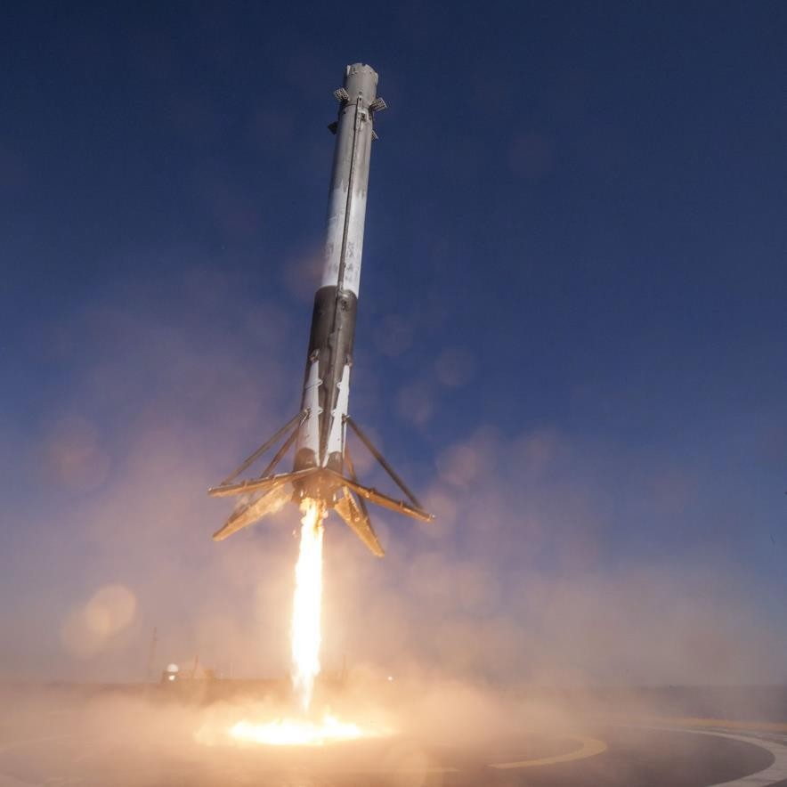
Introduction
Background
SpaceX offers the most competitive pricing, with launch costs at $62 million compared to $165 million USD from competitors. This cost advantage is primarily due to its ability to recover and reuse the first stage of the rocket. Now, SpaceY aims to enter the market and compete with SpaceX by adopting a similar approach.
Problem
Space Y tasks us to train a machine learning model to predict successful Stage 1 recovery

Slide 5

Section 1

Slide 6
Methodology
Executive Summary
Data collection methodology:
Combined data from SpaceX public API and SpaceX Wikipedia page
Perform data wrangling
Classifying true landings as successful and unsuccessful otherwise
Perform exploratory data analysis (EDA) using visualization and SQL
Perform interactive visual analytics using Folium and Plotly Dash
Perform predictive analysis using classification models
Fine tuned and trained models using GridSearchCV

Slide 7
Data Collection
Data Collection Process
The data was gathered through a combination of API requests from SpaceX’s public API and web scraping from a table in SpaceX’s Wikipedia page.
The upcoming slide will illustrate the flowchart outlining the API data collection process, while the following slide will depict the flowchart for web scraping.
SpaceX API Data Columns:
FlightNumber, Date, BoosterVersion, PayloadMass, Orbit, LaunchSite, Outcome, Flights, GridFins, Reused, Legs, LandingPad, Block, ReusedCount, Serial, Longitude, Latitude
Wikipedia Web Scraping Data Columns:
Flight No., Launch Site, Payload, PayloadMass, Orbit, Customer, Launch Outcome, Booster Version, Booster Landing, Date, Time

Slide 8
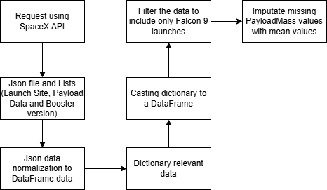
Data Collection – SpaceX API
https://github.com/Platinum-Pluto/Applied-Data-Science-Capstone/blob/main/Module_1/jupyter-labs-spacex-data-collection-api.ipynb

Slide 9
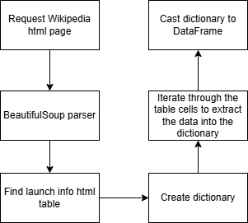
Data Collection - Scraping
Here the data is collected through various steps from wikipedia using python packages and data preprocessing of the html webpage.
https://github.com/Platinum-Pluto/Applied-Data-Science-Capstone/blob/main/Module_1/jupyter-labs-webscraping.ipynb

Slide 10
Data Wrangling
Creating a Training Label for Landing Outcomes
A new training label column, ‘class’, was introduced to classify landing results, where successful landings = 1 and failed landings = 0.
The ‘Outcome’ column consists of two components: ‘Mission Outcome’ and ‘Landing Location’. The ‘class’ column is assigned a value of 1 if the ‘Mission Outcome’ is True, and 0 otherwise. This way all the data was wrangled and processed for the training labels and landing outcomes of the dataset for the whole system.
Value Mapping:
- True ASDS, True RTLS, True Ocean → 1
- None None, False ASDS, None ASDS, False Ocean, False RTLS → 0
https://github.com/Platinum-Pluto/Applied-Data-Science-Capstone/blob/main/Module_1/labs-jupyter-spacex-Data%20wrangling.ipynb

Slide 11
EDA with Data Visualization
Exploratory Data Analysis (EDA) was conducted on key variables such as Flight Number, Payload Mass, Launch Site, Orbit, Class, and Year to uncover patterns and relationships that could inform the machine learning model.
Various visualizations were used, including scatter plots for Flight Number vs. Payload Mass, Flight Number vs. Launch Site, and Payload Mass vs. Launch Site, which helped identify trends in payloads and launch site usage. The Orbit vs. Success Rate plot revealed how different orbits correlated with success, while Flight Number vs. Orbit and Payload Mass vs. Orbit provided further insights into how these variables interacted.
The Yearly Success Trend line graph highlighted changes in success rates over time, showing potential improvements in performance. Overall, the EDA helped identify key relationships that could contribute to building a more accurate machine learning model for predicting successful landings.
https://github.com/Platinum-Pluto/Applied-Data-Science-Capstone/blob/main/Module_2/edadataviz.ipynb

Slide 12
EDA with SQL
The dataset was imported into an IBM DB2 Database and accessed through SQL-Python integration for efficient data handling. Various SQL queries were executed to gain deeper insights into the dataset. These queries retrieved key details, including launch site names, mission outcomes, payload sizes for different customers, booster versions, and landing outcomes.
Additional queries explored the correlation between launch success rates and payload mass, analyzed boosters used for specific mission types, and identified launch site performance trends over time. This SQL-based approach provided a structured way to filter and aggregate relevant data, ensuring a comprehensive understanding of the dataset. The integration also enabled faster data retrieval and better analysis efficiency, paving the way for further model development.
https://github.com/Platinum-Pluto/Applied-Data-Science-Capstone/blob/main/Module_2/jupyter-labs-eda-sql-coursera_sqllite.ipynb

Slide 13
Build an Interactive Map with Folium
Folium maps were used to pinpoint launch sites, successful and failed landings, and demonstrate proximity to key locations such as railways, highways, coastlines, and cities.
These visualizations help analyze the strategic placement of launch sites and illustrate the correlation between landing success and geographic location.
https://github.com/Platinum-Pluto/Applied-Data-Science-Capstone/blob/main/Module_3/lab_jupyter_launch_site_location.ipynb

Slide 14
Build a Dashboard with Plotly Dash
Dashboard Visualizations
The dashboard features a pie chart and a scatter plot for data analysis.
The pie chart allows users to view the distribution of successful landings across all launch sites or focus on individual launch site success rates.
The scatter plot provides insights by selecting either all launch sites or a specific site, with payload mass adjustable via a slider ranging from 0 to 10,000 kg.
The pie chart helps visualize the success rates of different launch sites, while the scatter plot reveals patterns in landing success based on launch site, payload mass, and booster version category.
https://github.com/Platinum-Pluto/Applied-Data-Science-Capstone/blob/main/Module_3/Untitled39.ipynb

Slide 15
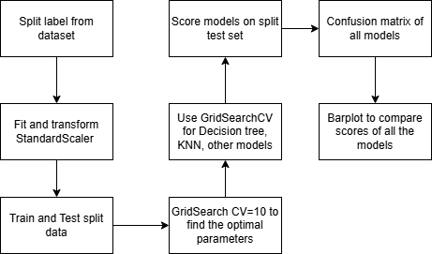
Predictive Analysis (Classification)
The full system contains various steps as shown in the diagram for the classification of various models on the dataset and how the whole workflow works. Here we split the data and fit and transform using StandardScaler first and then split it to train and test sets for training the models.
https://github.com/Platinum-Pluto/Applied-Data-Science-Capstone/blob/main/Module_4/SpaceX_Machine%20Learning%20Prediction_Part_5.ipynb

Slide 16
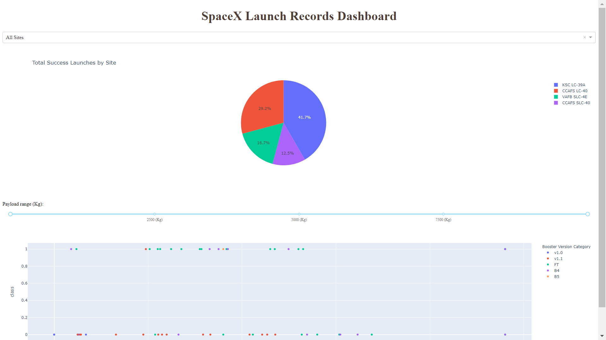
Results

Slide 17

EDA For data analysis

Slide 18
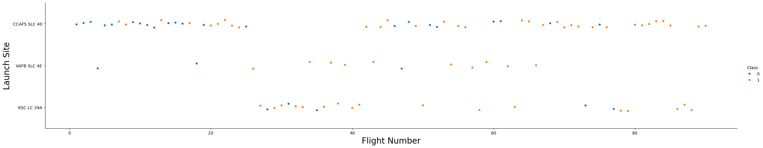
Flight Number vs. Launch Site
The graphic indicates a rising success rate over time, as reflected in the Flight Number progression. A significant breakthrough seems to have occurred around Flight 20, leading to a noticeable improvement in success rates. Additionally, CCAFS appears to be the primary launch site, handling the highest number of launches.

Slide 19
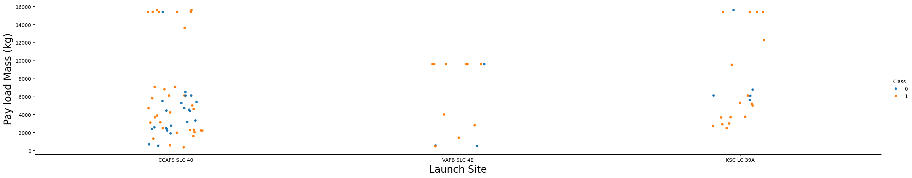
Payload vs. Launch Site
The majority of payload masses range between 0 and 6,000 kg. Additionally, different launch sites appear to handle varying payload capacities, suggesting possible site-specific constraints or preferences.

Slide 20
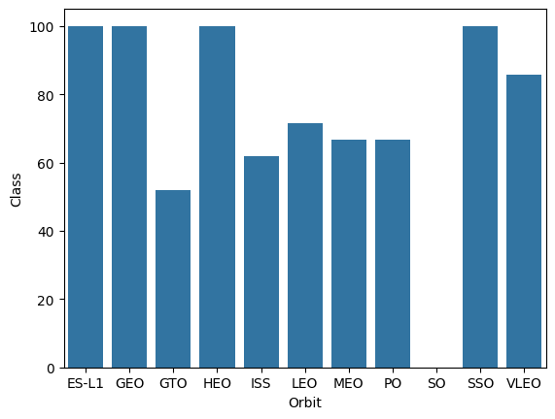
Success Rate vs. Orbit Type
Success Rate Scale with 0 as 0%
0.6 as 60% 1 as 100%
ES-L1 (1), GEO (1), and HEO (1) all have a 100% success rate, though with limited sample sizes. SSO (5) also maintains a 100% success rate with slightly more attempts. VLEO (14) shows a moderate success rate with a reasonable number of launches. SO (1) has a 0% success rate, while GTO (27), despite having the largest sample size, achieves around 50% success.

Slide 21
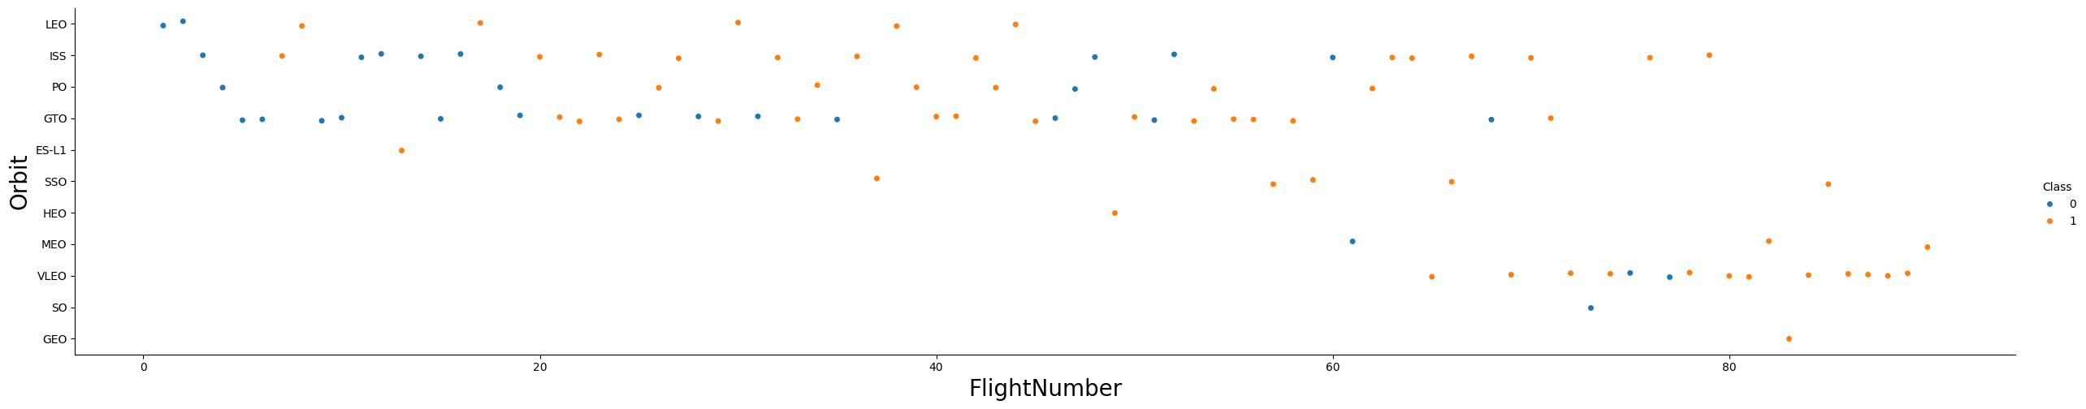
Flight Number vs. Orbit Type
Launch orbit preferences evolved over time, showing a correlation with launch outcomes. Initially, SpaceX focused on LEO orbits, achieving moderate success before shifting towards VLEO in more recent missions. The data suggests that SpaceX tends to perform better in lower orbits and Sun-synchronous orbits.

Slide 22
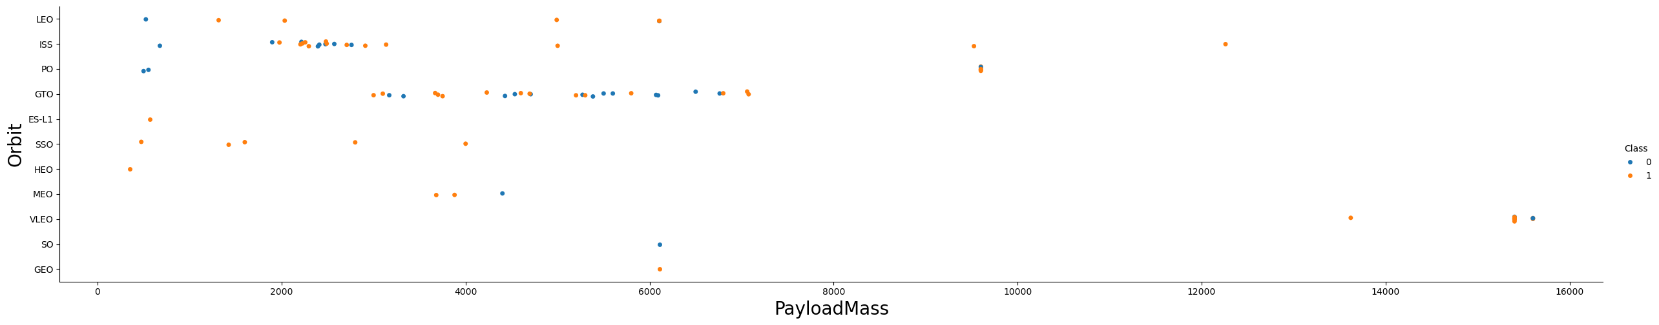
Payload vs. Orbit Type
Payload mass appears to be linked to orbit type. LEO and SSO generally have lower payload masses, while VLEO, another highly successful orbit, tends to carry payloads on the higher end of the mass range.

Slide 23
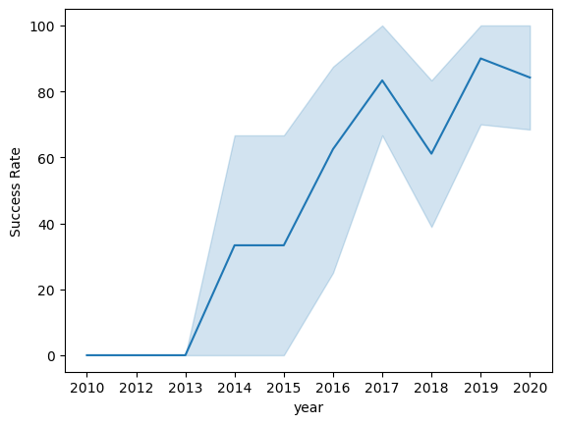
Launch Success Yearly Trend
Overall success rates have shown an upward trend since 2013, with a minor decline in 2018. In recent years, the success rate has stabilized at approximately 80%.

Slide 24
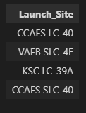
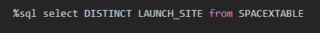
All Launch Site Names
A query was executed to retrieve unique launch site names from the database. It appears that CCAFS SLC-40 and CCAFSSLC-40 likely refer to the same launch site, suggesting a data entry inconsistency. Additionally, CCAFS LC-40 was its former designation. After resolving naming discrepancies, there are likely only three distinct launch sites: CCAFS SLC-40, KSC LC-39A, and VAFB SLC-4E.

Slide 25
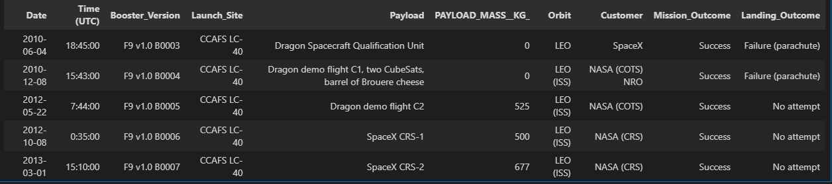
Launch Site Names Begin with 'CCA'
First five entries in database with Launch Site name beginning with CCA.

Slide 26
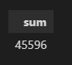
Total Payload Mass
This query calculates the total payload mass in kilograms for missions where NASA was the customer. CRS stands for Commercial Resupply Services, indicating that these payloads were delivered to the International Space Station (ISS).

Slide 27
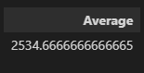
Average Payload Mass by F9 v1.1
This query computes the average payload mass for launches that utilized the booster version F9 v1.1. The average payload mass for F9 v1.1 is on the lower end of the overall payload mass range.

Slide 28

First Successful Ground Landing Date
The first successful ground pad landing was on the 2010-06-04 and this query returns the first landing date

Slide 29
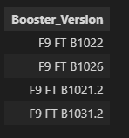
Successful Drone Ship Landing with Payload between 4000 and 6000
%sql select booster_version from SPACEXTABLE where (mission_outcome like 'Success') AND (payload_mass__kg_ BETWEEN 4000 AND 6000) AND (Landing_Outcome like 'Success (drone ship)')
This query retrieves the four booster versions that successfully performed drone ship landings and had a payload mass between 4,000 and 6,000 kg

Slide 30
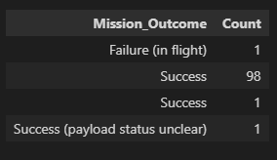
Total Number of Successful and Failure Mission Outcomes
This query returns the count of each mission outcome. SpaceX achieves its mission outcome successfully nearly 98% of the time, indicating that most landing failures are likely intentional. Interestingly, one launch has an unclear payload status, and unfortunately, one mission resulted in a flight failure.

Slide 31
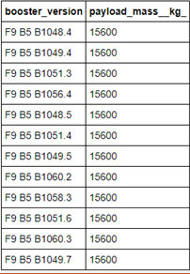
Boosters Carried Maximum Payload
This query retrieves the booster versions that carried the highest payload mass of 15,600 kg. All of these boosters belong to the F9 B5 B10xx.x series, suggesting a strong correlation between payload mass and the specific booster version used.

Slide 32
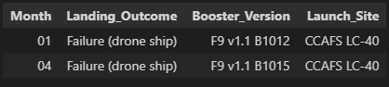
2015 Launch Records
%sql select strftime('%m', DATE) as Month, landing_outcome, booster_version, launch_site from SPACEXTABLE where substr(DATE, 0, 5) = '2015' AND landing_outcome like 'Failure (drone ship)'
This query retrieves the month, landing outcome, booster version, payload mass (kg), and launch site for 2015 launches where Stage 1 failed to land on a drone ship. There were two instances of such failures.

Slide 33
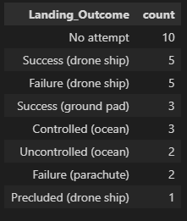
Rank Landing Outcomes Between 2010-06-04 and 2017-03-20
%sql select Landing_Outcome, count(*) as count from SPACEXTABLE where Date >= '2010-06-04' AND Date <= '2017-03-20' GROUP by Landing_Outcome ORDER BY count Desc
This query returns a list of successful landings and between 2010-06-04 and 2017-03-20.

Slide 34

Section 3

Slide 35

Launch Site Locations
The left map displays all launch sites in relation to the US map. The right map zooms in on the two Florida launch sites, highlighting their proximity to each other. Notably, all launch sites are located near the ocean.

Slide 36

Colored Launch Markers
On the Folium map, clusters can be clicked to reveal individual landings, represented by green icons for successful landings and red icons for failed ones. In this example, VAFB SLC-4E displays 4 successful landings and 6 failed landings.

Slide 37
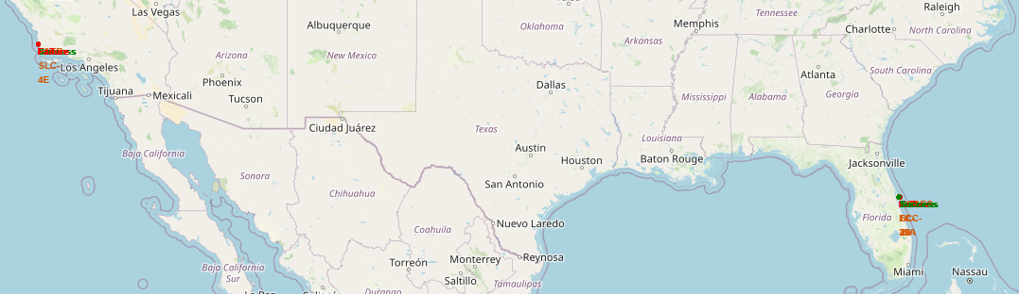
<Folium Map Screenshot 3>
Taking KSC LC-39A as an example, launch sites are typically situated near railways for efficient supply transportation. They are also close to highways for easy access by humans and supplies. Additionally, launch sites are located near the coastline and relatively far from cities. This strategic positioning ensures that in the event of launch failures, the rockets land in the sea, minimizing the risk of falling on densely populated areas.

Slide 38

Section 4

Slide 39
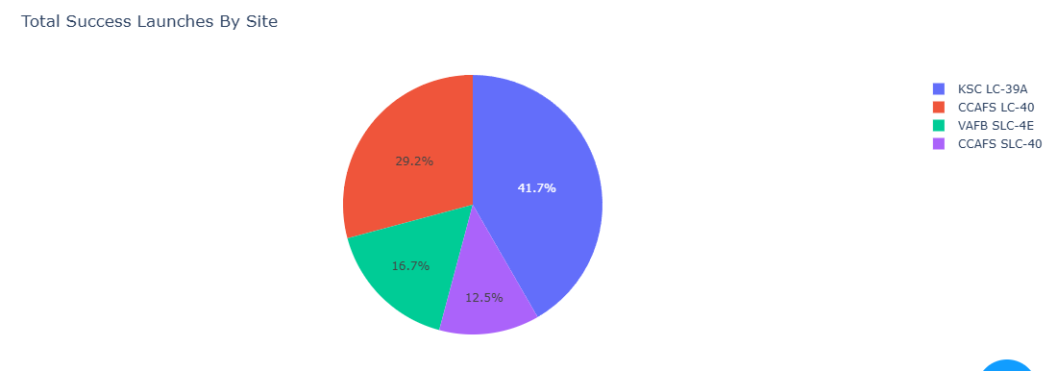
Sucessful Launches Across Launch Sites
This chart shows the distribution of successful landings across all launch sites. CCAFS LC-40 is the previous name of CCAFS SLC-40, so CCAFS and KSC have the same total number of successful landings, though the majority of these occurred before the name change. VAFB has the smallest share of successful landings, likely due to a smaller sample size and the increased difficulty of launching from the west coast.

Slide 40
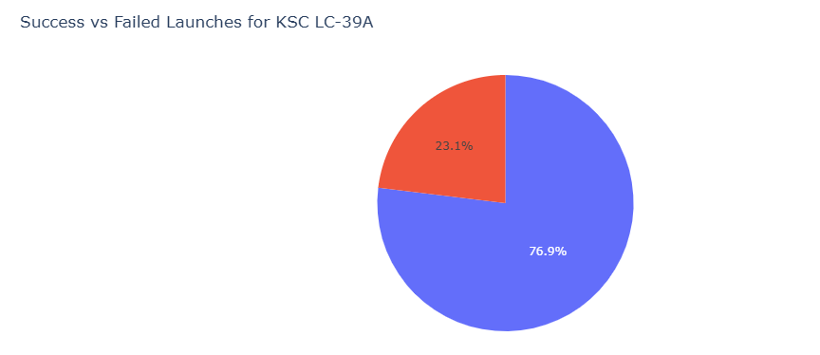
Highest Success Rate Launch Site
KSC LC-39A has the highest success rate with 10 successful landings and 3 failed landings.

Slide 41
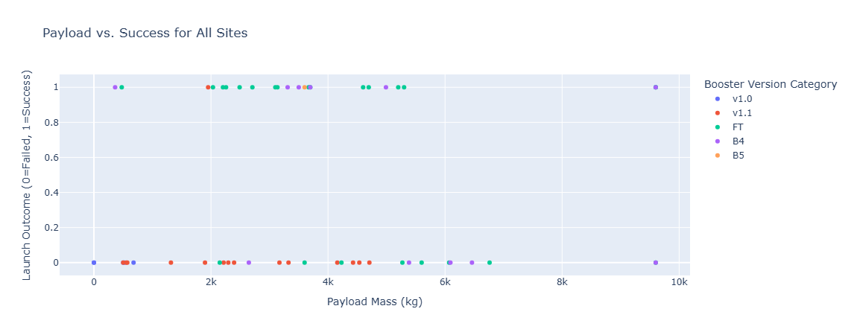
Payload Mass VS Success VS Booster Version Category
Plotly dashboard has a Payload range selector.

Slide 42

Section 5

Slide 43
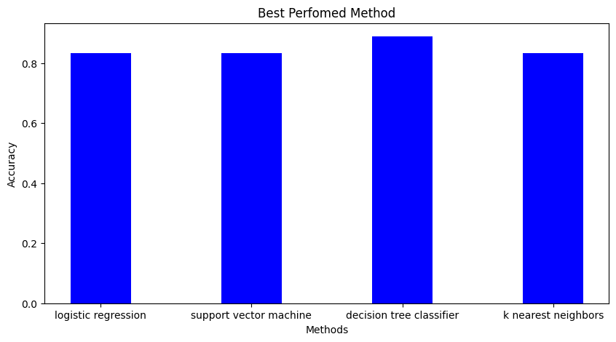
Classification Accuracy
Decision Tree Classifier gave the highest accuracy which was 88% and the others were 83%

Slide 44

Confusion Matrix
This is the confusion matrix of the Decision tree classifier. And the results are quite better than the other models and also it does not over predict as the other models.

Slide 45
Conclusions
Objective: Develop a machine learning model for SpaceY, aiming to compete with SpaceX.Goal: The model's goal is to predict the likelihood of Stage 1 successfully landing, potentially saving ~$100 million USD per launch.Data Sources:Data was collected from the public SpaceX API and web scraping from the SpaceX Wikipedia page.
Data Management:Created data labels and stored the dataset in a DB2 SQL database.
Visualization:Developed a dashboard for interactive data visualization.
Machine Learning Model:Trained a model that achieved an accuracy of 83%.
Application:Allon Mask, CEO of SpaceY, can leverage this model to predict with high accuracy whether a launch will result in a successful Stage 1 landing, allowing them to decide whether to proceed with the launch or not.
Future Work:To further enhance the model, additional data collection is recommended to refine the model selection and improve accuracy.

Slide 46
Appendix
GitHub Repo Link: https://github.com/Platinum-Pluto/Applied-Data-Science-Capstone/tree/main
Thank you to all the instructors for making the tutorials really fun and easy to learn.

Slide 47


